Slide 1
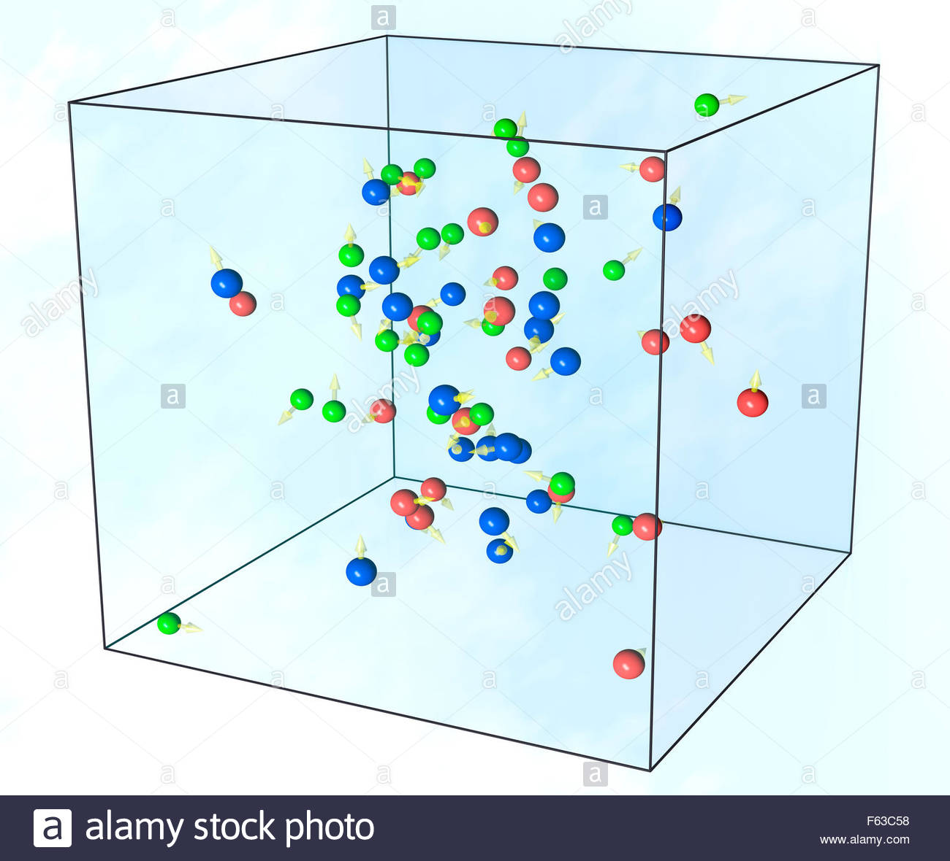
Subject: Physics 1 İnstructor: Ph.D. Khuraman Ahmadova x.khalilova@rambler.ru
Lecture 5. Molecular-kinetic theory of gases

Slide 2
OUTLINE
1.Temperature and Thermometry
2.The zeroth law of thermodynamics
3.Ideal gas.Gas laws.
4.The Equation of state of Ideal Gas.
5.The Kinetic-Theory of gas. The Kinetic-Theory Definition of Temperature.
6.The Barometric Formula
7.Distribution of Molecular Speeds.

Slide 3
Temperature and Thermometry
Many properties of matter change with temperature. For example, most materialsexpand when their temperature is increased.
Instruments designed to measure temperature are called thermometers.There are many kinds of thermometers.

Slide 4
Definitions of temperature and heat
Temperature is associated with molecular motion and temperature is a measure of the average random translational kinetic energy of molecules.
Heat is the net energy transferred from one object to another because of a temperature difference.

Slide 5
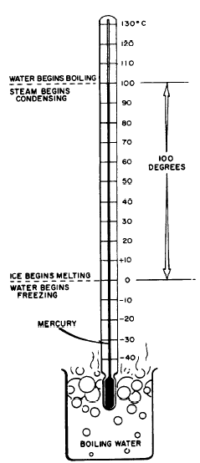

Temperature and Thermometry
In the Celsius temperature scale the two fixed points of reference are the ice point and the steam point.
The numbers assigned to these two points in the Celsius scale are arbitrarily chosen as 0 for the ice point and 100 for the steam point.
We may calculate the temperature by
where L_{o} is the distance between the 0º and 100º marks, and L is the distance the liquid is extended beyond the zero position.

Slide 6
Temperature and Thermometry
In both the Fahrenheit and Celsius temperature scales, the assignment of the zero point is arbitrary. We can readily achieve temperatures below these zero points. However, one temperature scale has a more fundamental choice of zero. This scale was proposed in 1848 by William Thomson, Lord Kelvin.
The conversion between Celsius and Kelvin temperatures is a simple one,
T(K) = T(ºC) + 273.15

Slide 7
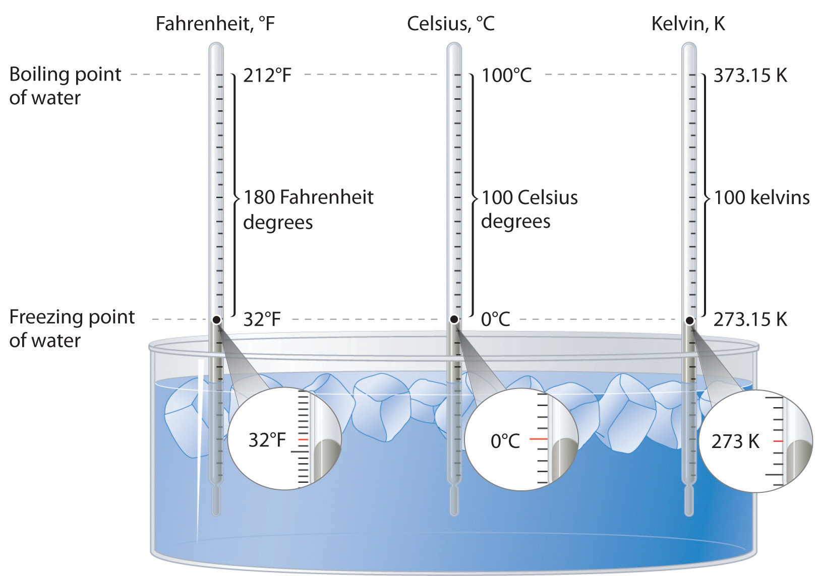
Temperature and Thermometry

Slide 8
Heat Transfer
Heat transfer takes place in three ways: conduction, convection, and radiation.
Conduction | Convection | Radiation
Relatively slow process | A more rapid process | A still more rapid
Heat energy is transferred without any net movement of the material itself. | Is accomplished through the mass motion or flow of some fluid | Realize by electromagnetic radiation (as a light radiation)
Environment is necessary. Not occur in a vacuum. | Environment is necessary. Not occur in a vacuum. | This process requires neither contact nor mass flow, nor any environment, and can pass through empty space (a vacuum).

Slide 9
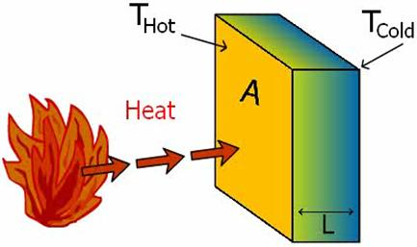

Heat Transfer Conduction
Suppose we imagine a wall of uniform material, that separates a warm room from a cold one. After a period of time, a steady temperature change occurs across the wall and a steady flow of heat goes from the warmer room to the cooler one
The time rate at which heat flows (ΔQ/Δt) through the wall is proportional to the area A, proportional to the temperature difference (T₂ - T₁), and inversely proportional to the thickness L of the wall.
K - the thermal conductivity [W/m·K]
A – area
L - thickness L of the wall
T₂ and T₁ – the wall temperature on the hot and cold side, respectively

Slide 10
Heat Transfer Conduction
A high thermal conductivity indicates a good heat conductor; a low thermal conductivity indicates a good heat insulator.
The effectiveness of insulation is rated by another quantity, called thermal resistance, or R value. The R value is the ratio of a material's thickness to its thermal conductivity:
R ≡ L/K
Example
Heat conduction from an oven.
A small oven has a surface area of 0.20 m². The insulated walls are 1.5 cm thick with an average thermal conductivity of 4.0 x 10 ⁻² W/m⋅°C. What is the rate of heat loss if the temperature inside the oven is maintained at 220°C and the outside temperature is 20°C?

Slide 11
Heat Transfer Radiation
The rate at which an object radiates energy is proportional to its surface area A and to the fourth power of its absolute temperature T. The total energy radiated from an object per unit time is
P = σeAT⁴ the Stefan-Boltzmann law
σ = 5.67 x 10 ⁻⁸ W·m⁻²K⁻⁴ is the Stefan-Boltzmann constant,
e - is a constant for given body called the emissivity. The emissivity is a dimensionless number between 0 and 1 that describes the nature of the emitting surface. The emissivity is larger for dark, rough surfaces and smaller for smooth, shiny ones. The book in your hand is radiating, but it is also absorbing radiation from its surroundings. If the book (or other object) is at a temperature T and its surroundings are at a different temperature T_{s}, the net energy gained (or lost) by the book is given by
P_{net} = σeA(T⁴ – T_{s}⁴)
where A is the surface area of the book.

Slide 12
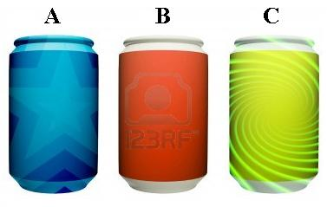
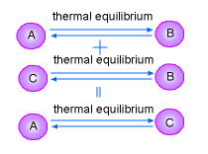
The Zeroth Law of Thermodynamics
We see that two objects in thermal contact can exchange heat as long as they are at different temperatures. The warmer object cools as the cooler one warms until they reach a common temperature at which no further changes take place. Two objects in this condition are said to be in a state of thermal equilibrium.
Two systems, each in thermal equilibrium with a third system, are in thermal equilibrium with each other.
This rule is known as the zero Law of Thermodynamics

Slide 13
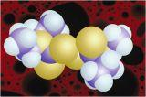
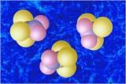
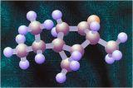
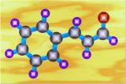
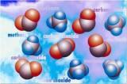
Molecular-kinetic theory of gases
1. All substances consists of molecules (atoms).

Slide 14
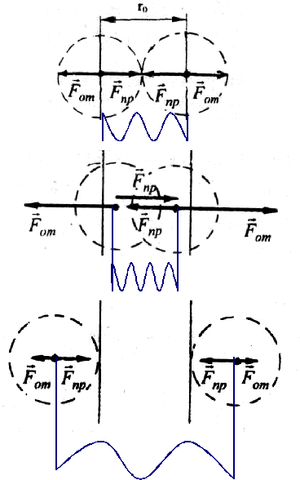
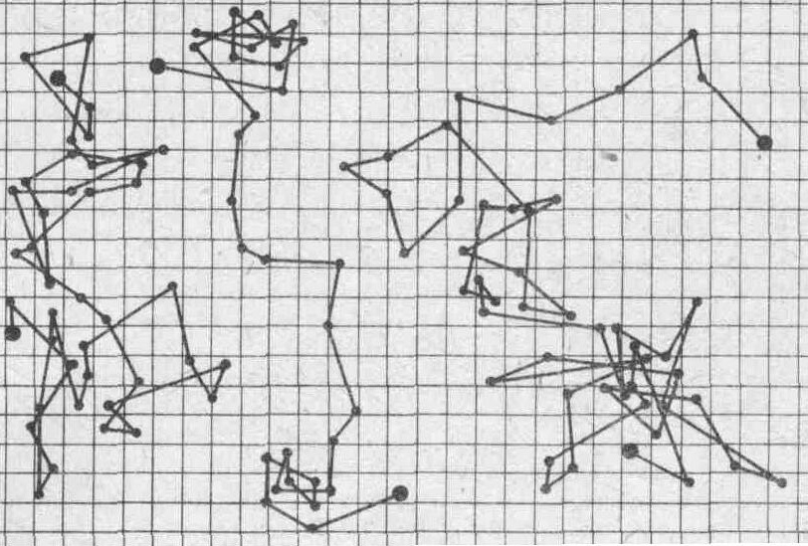

2. Molecules are in chaotic motion.
3. There are attractive and repulsive forces among molecules.

Slide 15
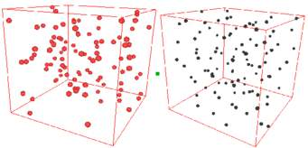
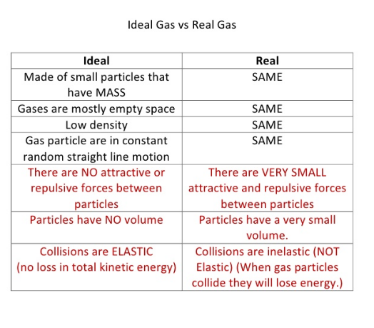
Differences between ideal and real gases
There particle does have real are some differences between ideal gas and real gas. The behavior of real gases is very much complex while the behavior of ideal gases is much simpler. The behavior of real gas can be more tangible by understanding fully the behaviour ideal gas. This ideal gas can be considered as a “point mass”. It simply means that the particle is extremely small where its mass is almost zero. Ideal gas particle, therefore, does not have volume while a real gas

Slide 16
The main principles of the molecular-kinetic theory (MKT) of an ideal gas.
The Kinetic Molecular Theory of Matter states that the particles in all matter are in a constant state of motion.
The theory is used to explain the properties of solids, liquids and gases.

Slide 17
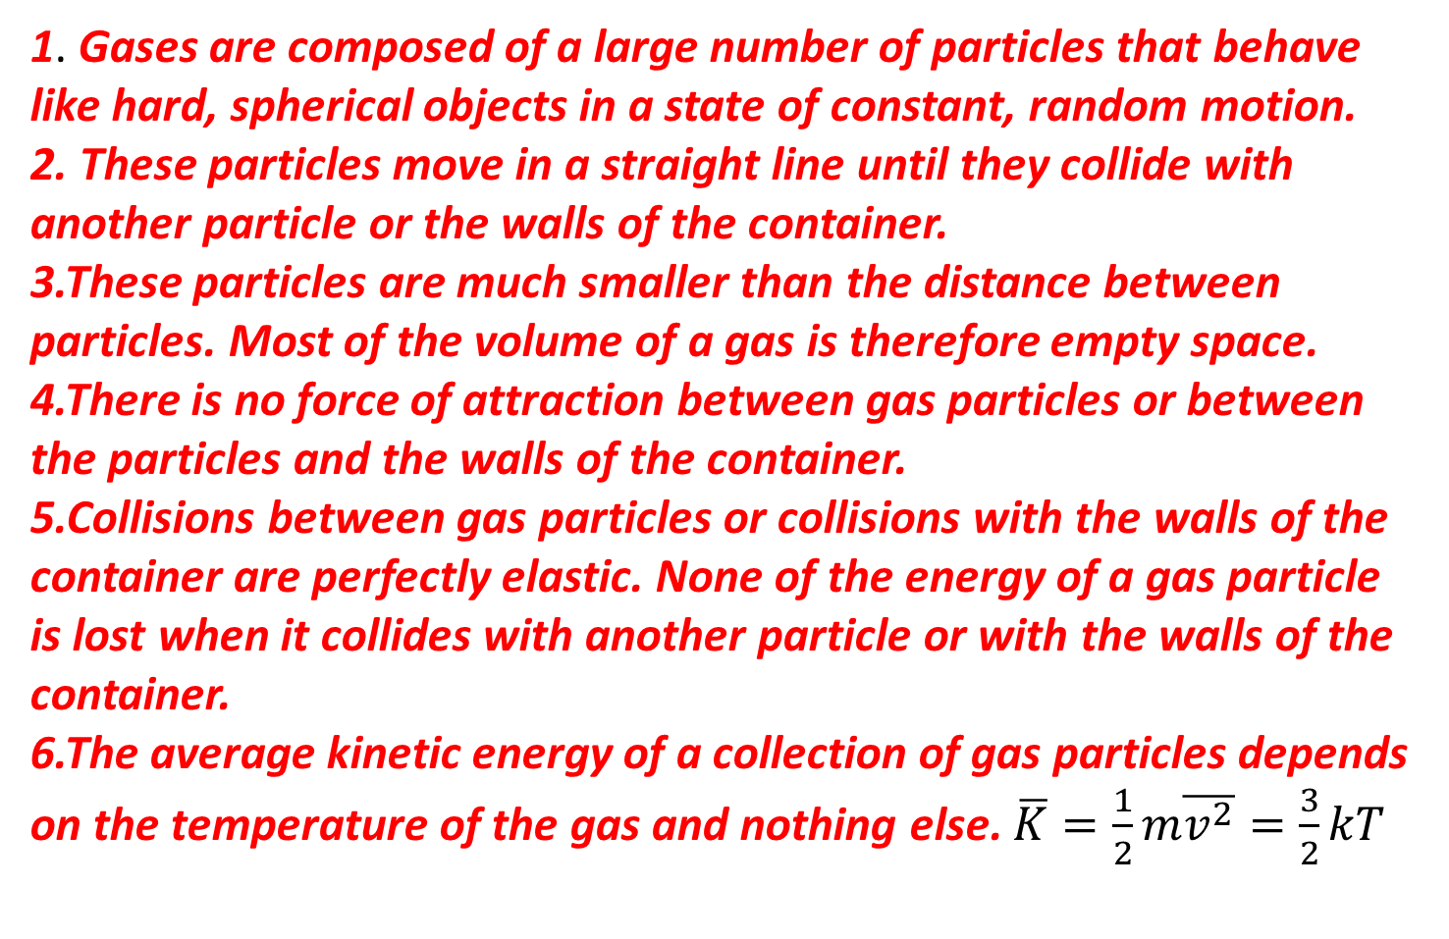
The Kinetic- Molecular Theory Postulates
1. Gases are composed of a large number of particles that behave like hard, spherical objects in a state of constant, random motion.
2. These particles move in a straight line until they collide with another particle or the walls of the container.
3.These particles are much smaller than the distance between particles. Most of the volume of a gas is therefore empty space.
4.There is no force of attraction between gas particles or between the particles and the walls of the container.
5.Collisions between gas particles or collisions with the walls of the container are perfectly elastic. None of the energy of a gas particle is lost when it collides with another particle or with the walls of the container.
6.The average kinetic energy of a collection of gas particles depends on the temperature of the gas and nothing else. $\overline{K}=\frac{1}{2}m\overline{v^{2}}=\frac{3}{2}kT$

Slide 18
The Ideal Gas Law
Boyle's law and the law of Charles and Gay-Lussac are special cases more general expression called the ideal gas law. It can be inferred from them and is usually written
PV = nRT
An equation that links the pressure, volume, and temperature of a sample of matter is called an equation of state.
Here, as before, P, V, and T stand for pressure, volume, and temperature, respectively.
The quantity of gas, measured in moles, is given by n.
A mole is the amount of material whose mass in grams is numerically equal to the molecular mass of the substance.

Slide 19
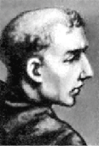
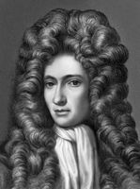
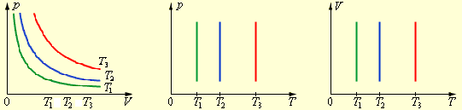


3. Ideal gas laws.
a) Isothermal process.
Boyle–Mariotte law T= const
Mariotte
Boyle

Slide 20
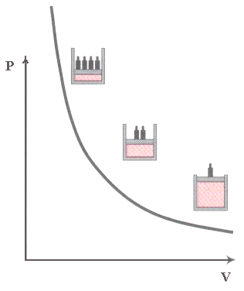
Boyle’s Law
Alternatively, Boyle’s law may be written
P₁V₁ = P₂V₂
where the subscripts 1 and 2 refer to different physical states of the same sample of gas with the temperature held constant.

Slide 21
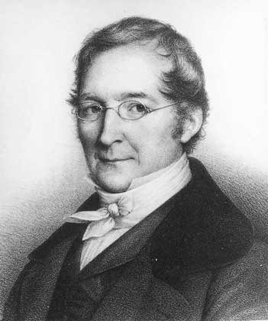
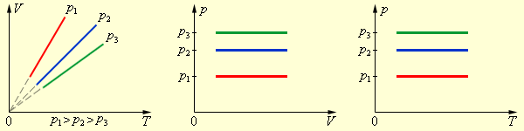
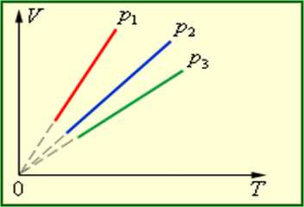
b) Isobaric process. Gay-Lussac's law
р= const
Gay-Lussac

Slide 22

The Law of Charles and Gay-Lussac
If the temperature is expressed in Kelvins, we find that, when the pressure is held constant, the volume is proportional to the temperature. This statement is the law of Charles and Gay-Lussac, which can be expressed mathematically as
As with Boyle's law, the amount of gas also must be held constant to be valid.

Slide 23
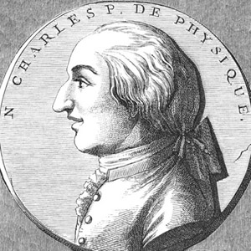
c) Isometric process. Charles' law
V= const
Charle

Slide 24
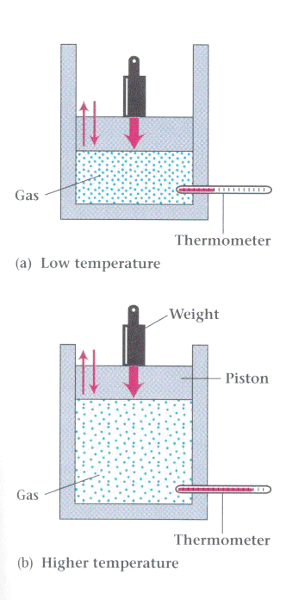
The Law of Charles and Gay-Lussac
Introduce some particular gas into the cylinder and place a weight on the piston. This arrangement creates an enclosed variable volume in which the pressure (due to the weight) remains constant. Then we bring the gas to thermal equilibrium at several different temperatures.

Slide 25
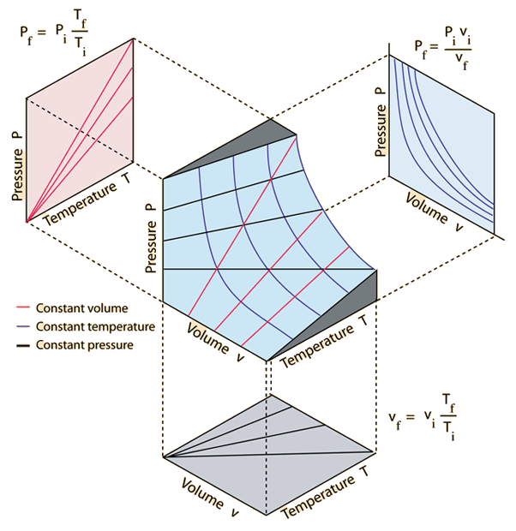

Slide 26
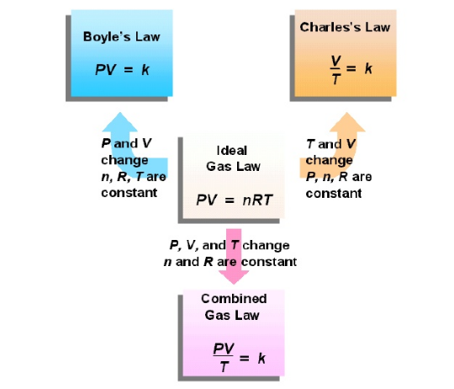
Ideal gas laws
Ideal gas laws.

Slide 27
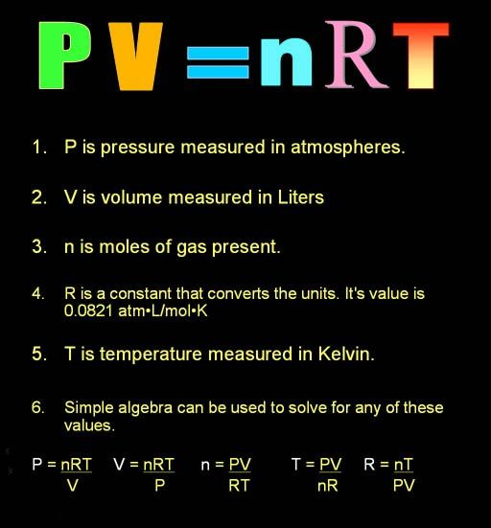
Ideal Gas Equation

Slide 28

The Ideal Gas Law
R is a constant that is the same for all gases, and so is called the universal gas constant. If pressure is measured in the SI unit of Pascals, volume in cubic meters, and temperature in Kelvins, then R has the value
R = 8.314 Joule/mole⋅K.
The modern definition of the mole
The mole is the amount of substance of a system that contains as many elementary entities as there are atoms in 0.012 kg of carbon-12
Avogadro's principle leads to the conclusion that a mole of any gas contains the same number of molecules. This number is called Avogadro's number, N_{A}, and is
N_{A} = 6.02 × 10²³ molecules/mole.

Slide 29
Equations of state of ideal gas.

Slide 30
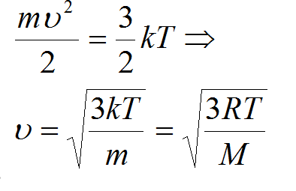
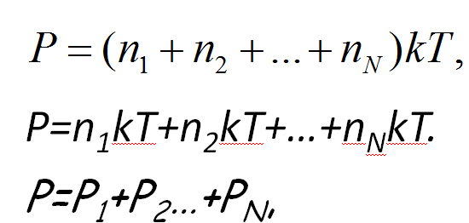
4.Root-mean-square-speed
5. Dalton's Law: the total pressure exerted is equal to the sum of the partial pressures of the individual gases

Slide 31
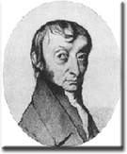
6.Avogadro’s Law
Avogadro's Hypothesis (V - n)
As the number of gas particles increases,
the frequency of collisions with the wa
For a fixed mass of an ideal gas at constant pressure and temperature, the volume and amount of the gas are directly proportionallls of the container must increase.
V = constant . n
V₁ / n₁ = V₂ / n₂
One of the most practical results of this law is the molar volume of a gases, V_{m}, which is about:
V_{m} = 22.4 dm³ / mol

Slide 32
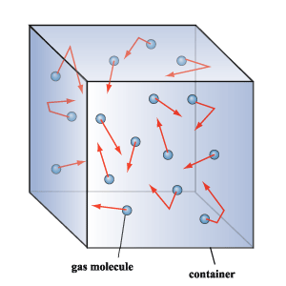
The Kinetic Theory of Gases
In the kinetic theory of gases, we assume that a gas consists of many particles. Here "many" means so numerous that we cannot hope to trace out their individual paths. If we do not treat the molecules individually, then we must determine their average behavior. This implies that we need to develop a statistical theory that includes the rules of probability.
We start by considering an ideal gas confined to a cubical box with sides of length L.
Consider a molecule of mass m moving parallel to the x axis in the positive direction.

Slide 33


The Kinetic Theory of Gases
The average momentum change per unit time at face A is
The total force due to N molecules is
where the bar indicates, as before, the average of that quantity.
By dividing both sides of the equation by the area of the face A = L², we have the pressure P:

Slide 34







The Kinetic Theory of Gases
or
Since , where is the average kinetic energy per molecule, we have, where

Slide 35
The Kinetic Theory of Gases
The quantities on the left-hand side of are macroscopic (large-scale) quantities. The quantities on the right-hand side are microscopic (molecular-scale) variables. We have derived an expression linking the microscopic, and generally unobservable, properties of molecules, such as their masses and speeds, with the easily observed large-scale properties, such as pressure and volume.
Example
Average speed of a gas molecule.
Estimate the average speed of oxygen molecules at the standard temperature and pressure of 0°C and one atmosphere. Assume that oxygen can be treated as an ideal gas.

Slide 36

The Kinetic-Theory. Definition of Temperature
The product is the total kinetic energy of the gas. However, since we have not considered rotations or internal vibrations of the molecules in our model of a gas, this kinetic energy represents the total internal energy of the gas, U. We know that
Thus we can write
PV = 2/3U
By combining this equation with the ideal gas law
PV = nRT
we can relate the internal energy to the temperature through
nRT = 2/3U

Slide 37


The Kinetic-Theory Definition of Temperature
So we can see, that
We get formula for internal energy of ideal gas of monoatomic moleculesу
n – mole of the gas
R – universal gas constant
By the another hand, if we combine formulas
and PV = nRT

Slide 38

The Kinetic-Theory. Definition of Temperature
we get the temperatures of ideal gas in terms of the average kinetic energy per molecule
Where k =R/N_{A} is called the Boltzmann constant k= 1.3807 × 10⁻²³ J/K
Temperature is a measure of the average kinetic energy of the molecules of a gas

Slide 39
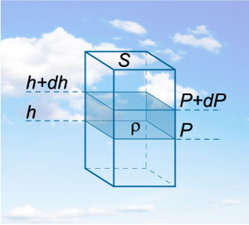
The Barometric Formula
We wish to find an expression for pressure as a function of height.
Starting at some point in midair, the change in pressure associated with a small change in height can be found in terms of the weight of the air. If we take an arbitrary gas column with intersection area S and height h, then the weight of this column is given by:
F=mg=ρgV=ρghS,
where ρ is the gas density. Then the gas pressure is expressed by the following formula:
P= F/S= ρghS/S=ρgh.

Slide 40



Now imagine such a column in the atmosphere and separate a thin layer of air with the height dh. It’s clear that such a layer causes the pressure change by the value of
dP=−ρgdh.
We have put the minus sign because the pressure must decrease as the altitude increases.
Considering atmospheric air as an ideal gas, we can use the ideal gas law to express the density ρ through pressure P:

Slide 41
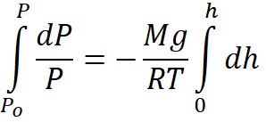


We obtain a differential equation describing the gas pressure P as a function of the altitude h. Integrating gives the equation:
where we use, that M/R =m/k

Slide 42

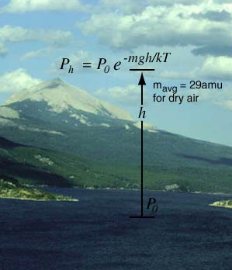
where P₀ - the pressure at height h = 0
P - the pressure at height h = z
m - the mass of one molecule
g - free fall acceleration
k - the Boltzmann constant
e - an irrational number with a value approximately equal to 2.718.

Slide 43
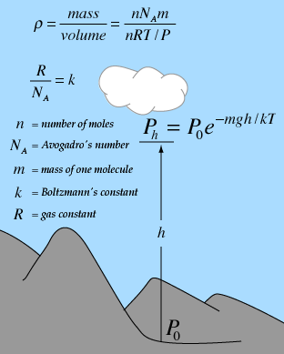
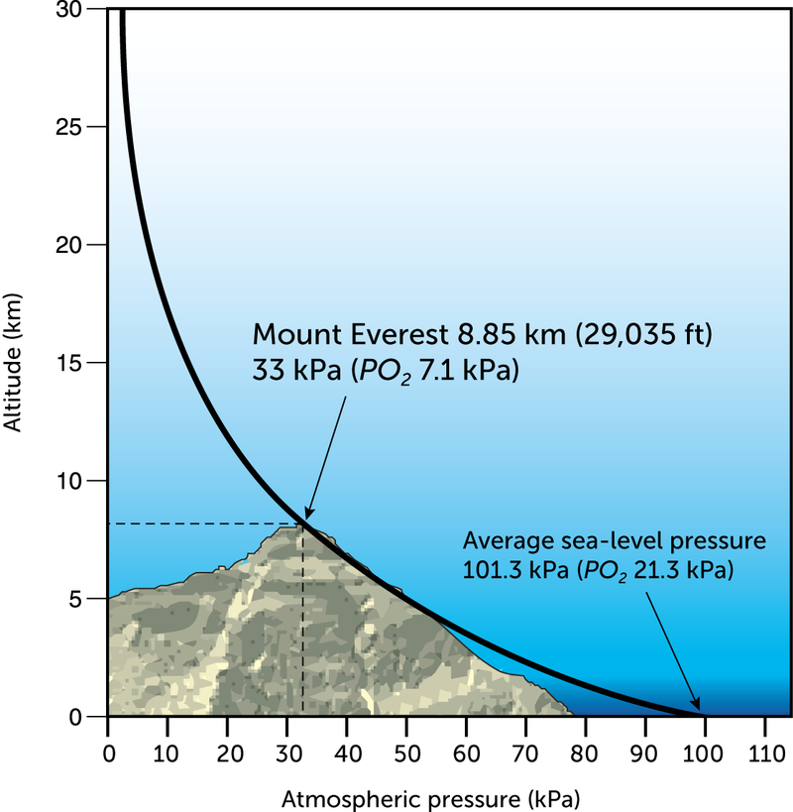

Slide 44

The Barometric Formula
We may also express this equation in terms of the number density n, the number of molecules per unit volume. We can do so because at constant temperature, the pressure and density of an ideal gas are proportional. Thus
This equation also is called the barometric formula. It gives the number of molecules per unit volume as a function of height z in our idealized atmosphere.

Slide 45
The Distribution of Molecular Speeds
We have considered only the average speeds of molecules. However, there are times when we need to know the distribution of the molecular speeds in a gas.
By distribution we mean a mathematical expression that tells us what fraction of the molecules have speeds in a given range.
The problem of the distribution of molecular speeds was first solved by James Clerk Maxwell (1831-1879) in 1860. Maxwell's significant contribution was the introduction of statistical ideas into classical mechanics.

Slide 46

The Distribution of Molecular Speeds
The Maxwell-Boltzmann distribution function:
where f(v) is the fraction of molecules that have speeds between v and v + Δv.
m - the mass of one molecule
T - temperature
k - the Boltzmann constant
e - an irrational number

Slide 47
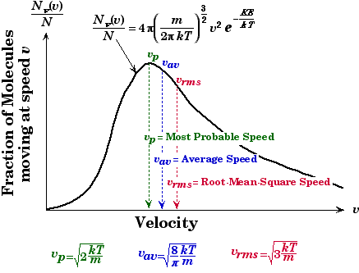
The Distribution of Molecular Speeds

Slide 48
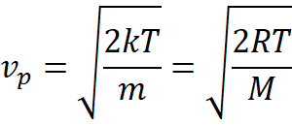
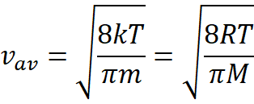
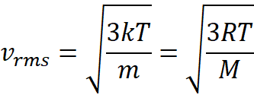
The Distribution of Molecular Speeds
Most probable speed:
Average speed:
Root mean squired speed:

Slide 49
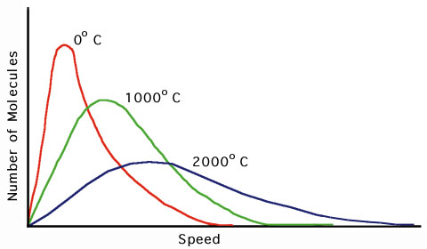
Figure represents speed distribution curves for different temperatures. The peak in each curve shifts to the right as T increases, indicating that the average speed increases with increasing temperature, as expected.
Because the lowest speed possible is zero and the upper classical limit of the speed is infinity, the curves are asymmetrical.

Slide 50
The speed distribution curves for molecules in a liquid are similar to those shown in Figure. We can understand the phenomenon of evaporation of a liquid from this distribution in speeds, given that some molecules in the liquid are more energetic than others. Some of the faster-moving molecules in the liquid penetrate the surface and even leave the liquid at temperatures well below the boiling point.
The molecules that escape the liquid by evaporation are those that have sufficient energy to overcome the attractive forces of the molecules in the liquid phase. Consequently, the molecules left behind in the liquid phase have a lower average kinetic energy; as a result, the temperature of the liquid decreases.
Hence, evaporation is a cooling process. For example, an alcohol-soaked cloth can be placed on a feverish head to cool and comfort a patient.

